Slide 1
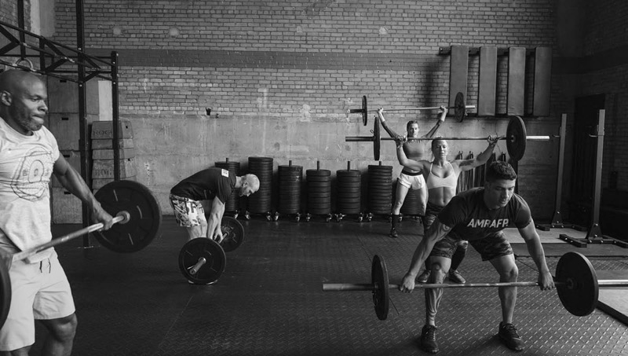
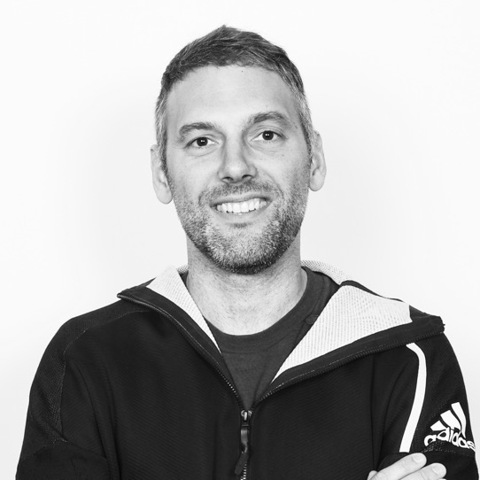
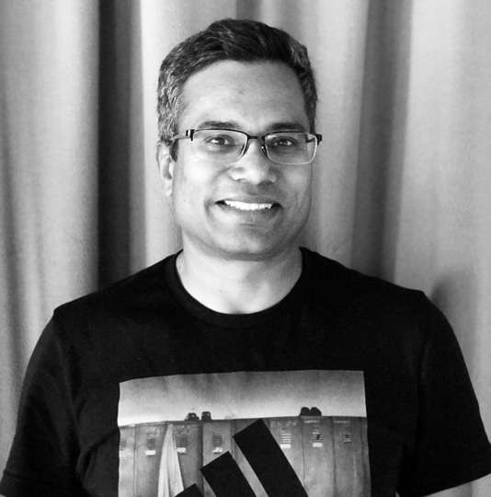

FERNANDO CORNAGO
VP DIGITAL TECH
VIKALP YADAV
SR.DIRECTOR DIGITAL SRE OPERATIONS
ANDREIA OTTO
SRE CHAMPION WnM SERVICES
Notes:
My name, for the ones connecting this year for the first time, is Fernando Cornago and I’m since this month heading-up Digital Technology for adidas after 6 years in the Company working in the foundations, Platform Engineering and the Engineering expansión across our Tech Hubs.
This year, as I said, we Deep dive in Operations at Scale, for this, I brought with me Vikalp, the head of Digital Operations and Andreia, one of our super-talents and currently in charge of the SER team of one of our most critical áreas, Web and Mobile Services, that contains topics such as (Content and Product Data Management our Checkout API)

Slide 2
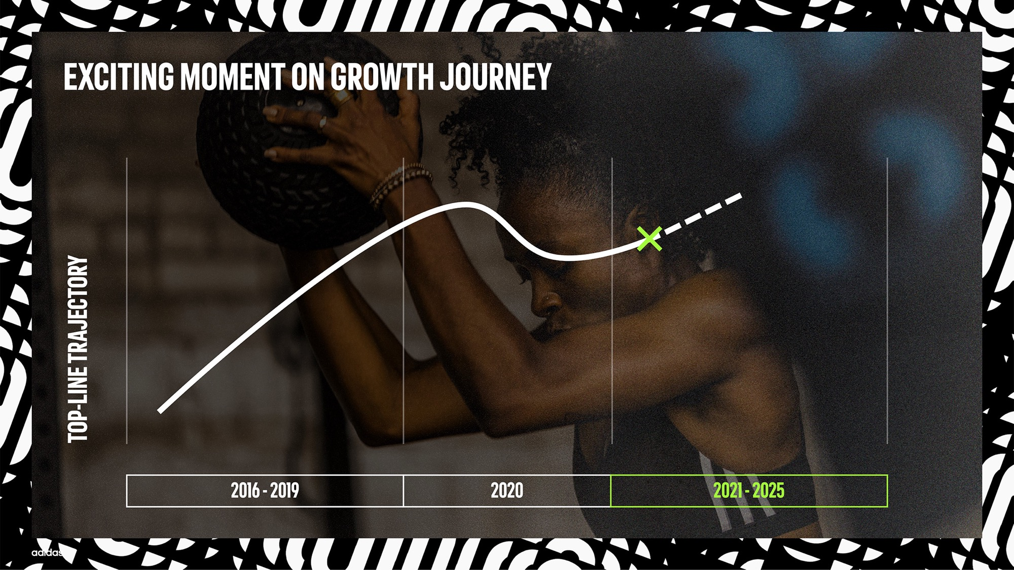
20% TECH BUDGET CUT
COST CONTROL TOWER AND ZERO-BUDGET
53% DIGITAL GROWTH
Notes:
Well, let’s start from where we are coming from…
We had 4 record years between 2016 and 2019: the relentless execution of Creating the New, our former strategy, delivered exceptional brand momentum and financial results.
Then, 2020 allowed us to prove our resilience and prepare for the future -despite all the unprecedented challenges Covid-19 threw at us.
It was also a year that accelerated structural trends in our industry, making the sporting goods market even more attractive.
2020 also was especially tough for Technology, where we had to strip down our budget more than 20% while our most demanding area, all our Direct-To-Consumer Digital Touchpoints experienced the biggest growth in our history. An area moving from 500M revenue in 2015 to more than 4Billion in 2021 and 9Billion target in 2025.
It was also a year without a CIO. That situation forced all the Tech Management team including myself to move towards Value Driven conversations with our Board Members. The final result, as you will see, it’s 3 years progress in 1 single year.

Slide 3




OUR PRODUCT DOMAIN MAP AS BASE OF OUR DECISIONS
DOMAINS
PRODUCT AREAS
TECH INVESTMENT STRATEGY
DIGITAL
SALES
CONSUMER & CUSTOMER EXPERIENCE
.com Experience
Mobile/ Hype/ Digital Retail
Consumer Engagement & Traffic Generation
Store Experience
Customer Experience & Commerce
WIN
Prioritize invest to create differentiated competitive advantage by engineering best-in-class solutions
Web & Mobile
Services
Consumer Analytics
China Digital Hub
Web & Mobile Programs and Operations
Consumer Order Mgmt.
Sales Services
PLAN, DESIGN & MANAGE PRODUCT
Brand Activation
Merch. Insights, Analytics & Planning
Product Management
Product Design
Merchandising Execution
Digital Asset Mgmt.
Brand & Creation Tech Foundation
CREATE PRODUCT & SUPPLY CHAIN
Product Development
Sourcing
Product Supply
Fulfilment
Logistics & Customs
Distribution
COMPETE
Constrain costs by leveraging market leading 3rd-party solutions with limited customization
MANAGE BUSINESS
Integrated Planning
Record to Close
Close to Group Reporting
Order to Cash
Source to Pay
Hire to Retire
Corp. Business Functions
Workplaces
FOUNDATIONAL
Evaluate spend through lens of maximizing business & tech cost efficiencies
Enterprise Platforms
Data and Integration Platforms
Cloud Native Engineering
Managed Cloud
Digital Workplace
Connectivity
HW & SW End User Support
Data & Analytics
Application Operations
ENABLING
LEGEND:
Build: Where we must differentiate and have existing capability, accelerate internalization and utilize best of breed partners​ (niche specialist)
Rent: Where we want to drive efficiencies, leverage out of the box software (SAAS or COTS) and minimize customization​
Buy: Where we must differentiate but lack capability, explore acquisition, acquire or JV opportunities
Notes:
As I showed last year, our Product Domain Map is the center of every decision we do.
Last year, it was more clear than ever the differentiation between:
Red Areas where we Win and differentitate from our competitions, this is where our change budget goes and where we build unique solutions with our more than 1200 Internal Engineers + our big network of extended partners
Blue Areas and Grey where we compete or maximize efficiencies, where our selections are typically Renting or Buying software that helps us with our TTM and operations
CLICK
This is, as I told you before, my personal journey. Moving from the foundations to the execution and shaping the future or our Digital Touchpoints. Definitely the area where we should win as a Company, in our .COM, Mobile and Hype Experiences, Membership programs, fueled of course by our Consumer Analytics.

Slide 4
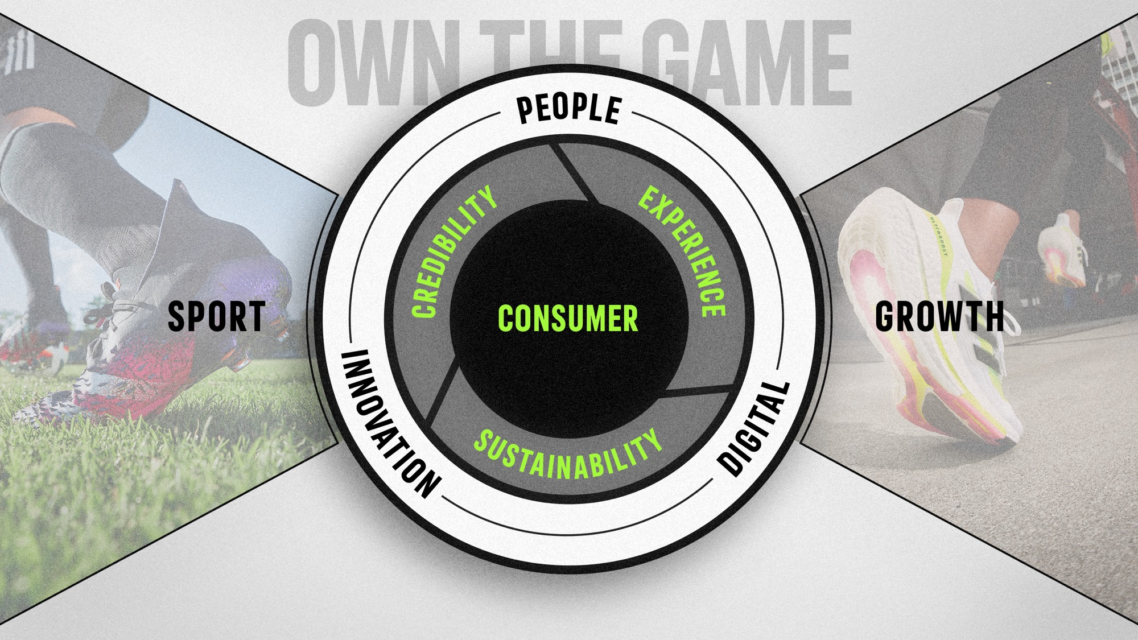
OWN THE GAME SLIDE 1 - OVERVIEW
Notes:
So, let’s deep dive in our 5-year strategy: Own the Game.
Own the game is rooted in sport – our past, present and future.
We own the game because we have what it takes and control our destiny in a Growing Sporting Goods Market
We put the consumer at the heart of everything our people do.
Our three strategic focus areas are
to-increase brand credibility
elevate the experience for our consumer
and push the boundaries on sustainability.
Two enablers will set us up for success: innovation across the entire company and the acceleration of our digital transformation throughout our entire value chain.
Let‘s focus on 2 things today:
Our experiences, where we win
Digital, how we win

Slide 5
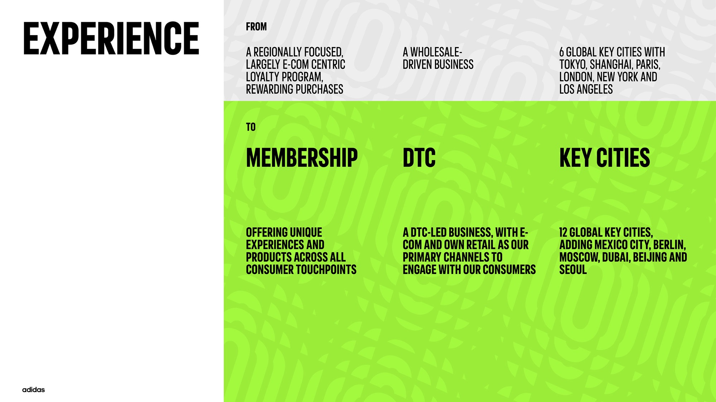
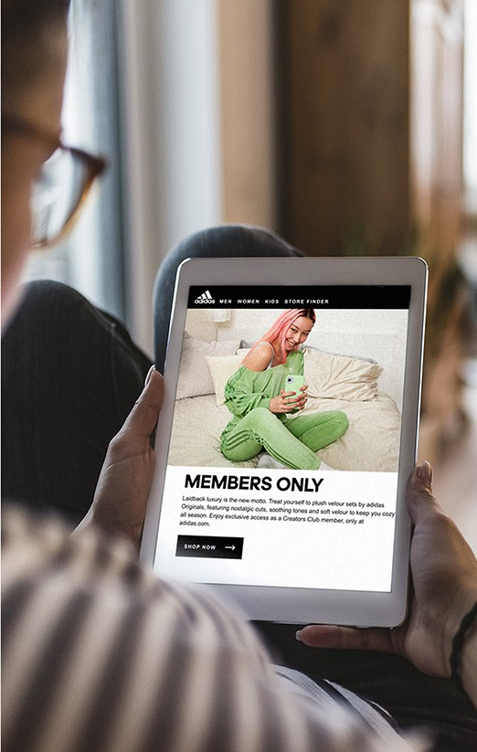
Notes:
Our Experience by 2025 will no longer think in ‘channels’.
We will move beyond online and offline to own the game by fully embracing and embedding consumer experience as our strategic focus area.
First, we will become a member-first brand: We will connect 500 million members through personalized experiences and amazing brand moments.
500M adidas members, that means 1 of every 4 Whatsapp users is an adidas member.
Second, we will evolve our operating model to address consumers more directly: We move to a 50% Direct-to-Consumer Business.
This changes dramatically our Company Operating Model, from clear wholesale-based 2 year calendars from ideation to shelf, into taking real-time business decisions in Hype drop or special event.
Our Key Cities remain the global amplifiers of trends and therefore we will expand our portfolio from 6 to 12

Slide 6
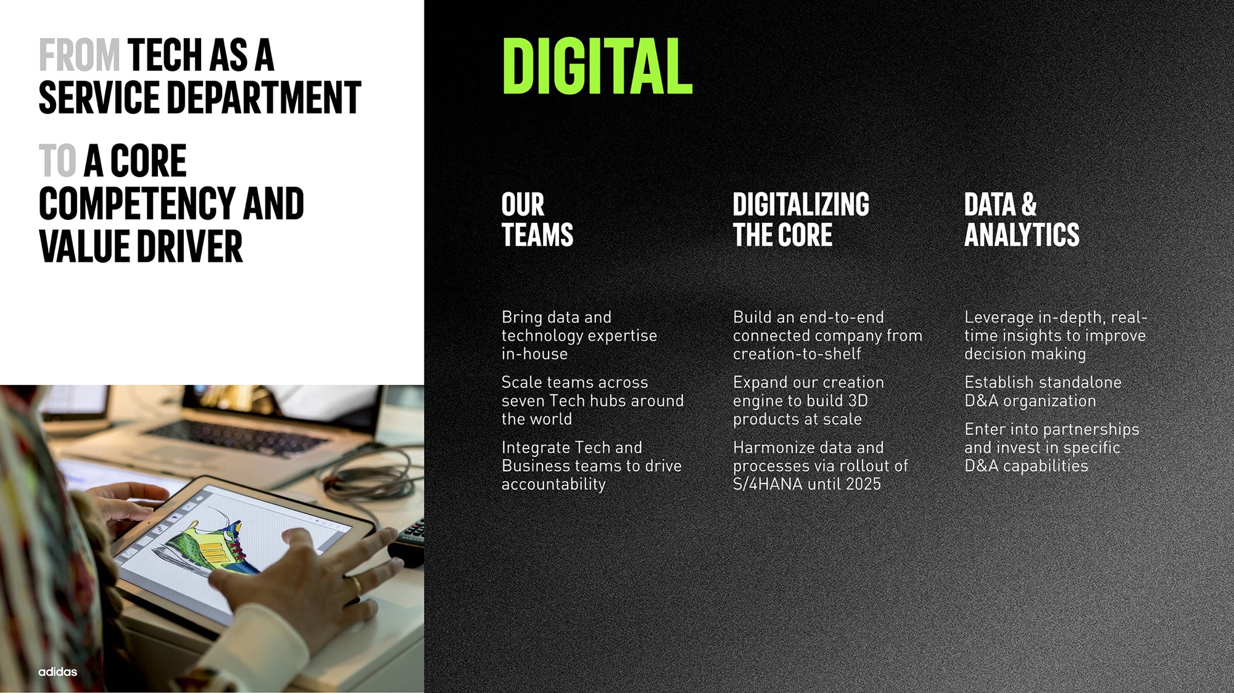
Notes:
This changes require a repositioning on the role of tech. Moving from a service department into a core Competency and Value Driver. This is a journey we started 5 years ago. Thanks to this we are on the table of decision making.
We’re significantly investing in building up our own internal Tech talent in seven Tech Hubs around the world, and already in 2021 we’ll hire over 750 people and increase our total Engineering team size by 50%. To ensure we drive the greatest impact, Tech and Business will be integrated in a Product-led setup to drive end-to-end accountability.
We’re also investing in digitalizing the core processes of our company. By 2025, the vast majority of our Net Sales will come from products that are created and sold-in digitally. For that, we’ve established a digital transformation program to build up capabilities including our 3D Creation Engine, the Digital Go-to-Market, where customers or wholesalers can plan their assortment digitally and our foundation, where we will implement a new ERP system, S/4HANA.
With a digital-first mindset, we cannot forget the use of Data. We move from leveraging our consumer insights through advanced analytics in our e-com business, to establish these capabilities fully end-to-end, from Creation, Manufacturing, Logistics and Sales.

Slide 7

Right sourcing | OPERATING MODEL TAYLORED FOR ADIDAS
ORGANIZATIOINS ARE LIVING CREATURES ADAPTED TO THE HUB VISION AND THE REALITY OF EACH MARKET
Bring data & technology expertise in-house
integrating Tech and Business to drive end-to-end accountability
Empowered to shape global capability
Product
Product led
1
</>
2
3
Capability
Chapter logic
Hub
Operating model
Notes:
Let me deep-dive on the people…
- Onboarding 750 people in 7 different locations is not easy.
- We make all the efforts for every single Engineer we’re hiring to fill a critical role for the Company’s success.
- They need to feel this duality between:
- their product and the value that is driven for the Company
- and their capability, their career, their craft
All of that, empowered by a Hub Strategy. Hubs are not places where we throw people. They have a motto, they have a vision, a global purpose. This help with hiring, retention, belonging and innovation.
For example, our Zaragoza Hub in Spain, the first one created is pivoting from pure development into platforms, services and SRE
While the new hub in India, is building our future capabilities in eCom, Retail or Planning.

Slide 8
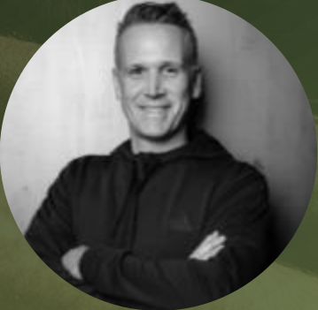

WHAT OUR BUSINESS SAYs aBOUT tech
SCOTT ZALAZNIK, SVP DIGITAL
Thank you for delivering the biggest growth in our most difficult time ever
Adidas should be the most technically savvy and progressive with regards to our ways of working
We will only win with tech at our core and data as our catalyst
There are no reporting lines or batches, engineers and architects should speak up in product conversations
NIGEL GRIFFITHS, SVP SALES
Only by understanding data across our entire value chain we will be in the position to improve our product design, supply chain or forecasting.
I don’t go anywhere without tech on the table
Notes:
And what happens when you invest in tech, and move from a Service Department into a Competency Enabler?
What happens when you integrate smoothly with your different businesses?
Our business leaders are proud of us, proud of tech:
So, my little piece of advice to all the different tech leaders around the globe: Invest in Engineering, Data and create Architecture roadmaps with regards to teams, interactions and Platforms, Build vs Buy decision. Speak up, show data and facts on your value stream (Lead/Flow time, MTTD or MTTR, etc.), be on the table and push decisions to the Product Owners. DON‘T BE A SERVICE DEPARTMENT ANYMORE

Slide 9

A REAL STORY ABOUT VOLUMES
Notes:
But let’s stop talking for a moment about Strategy… and get into a story about volume
And yes, you can see jesse owens… by using Adi Dassler’s technology with spikes in his shoes he was fast, the fastest.
It’s like a new small start-up, they can adopt technology very fast and put it to live.

Slide 10
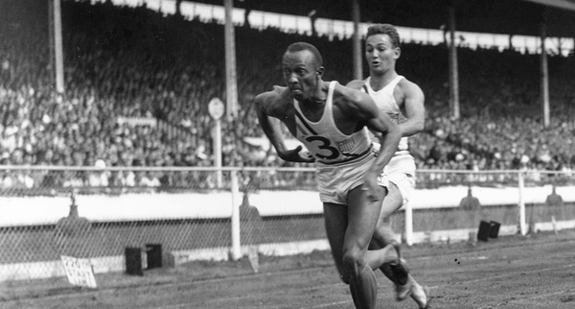
Notes:
But Jesse could have never run 400m in less than 40 seconds by himself, for that he needed a team, and 3 sincronyzed relays or handovers.
You can see this as a scale-up, or the adidas digital ecosystem growing free during the last 5 years.

Slide 11

Notes:
But… growth can kill you…. Imagine all these people crossing the bridge during the NYC marathon.
If one accelerates, jumps or stops, 10 others might fall on the floor.
This is basically what happened to us in November 2020

Slide 12
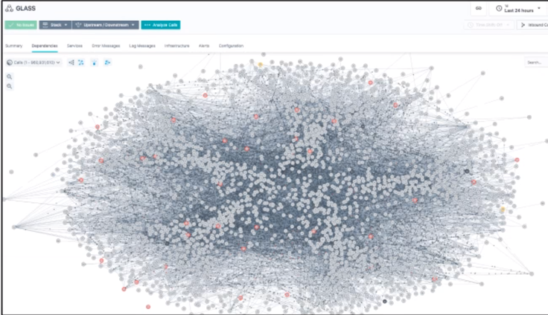
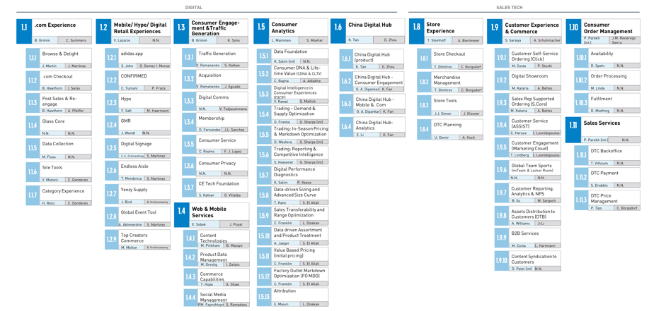
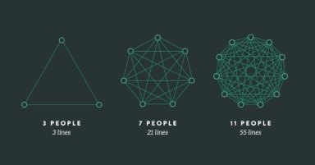
10X | GROWTH MINDSET
TECHNICAL, PROCESS AND TEAM DEPENDENCIES NEED TO BE TREATED AS LIVING COMPONENTS OF YOUR ECOSYSTEM
59 DIGITAL PRODUCTS
150-200 FEATURE TEAMS
1500 ENGINEERS
22000 K8s SERVICES
450 MILLION LOC
1.5 MILLION ReQUESTS PER SECOND
3 BILLION LOGS PER DAY
Notes:
We call our volume growth 10X.
10X is our growth rate over the last years, typically 50% digital business growth is bringing 2.5 more visitors to our channels and this creates 10 times more technical traffic in our different platforms.
But it’s not only that, our teams grow, as well as the dependencies and connections among them per brooks law.

Slide 13

NO GO!
GO!
NO GO!
GO!
GO!
NOVEMBER 2020
A VERY EXPENSIVE 6-EYE PRINCIPLE
GO!
Notes:
This, took as to a point last november where, after years of stability we got into a crisis mode after 4 / 5 outages telling us we had reached our limits in the worst time ever. Just before our peak sales period, Cyberweek, Black Friday, Cyber Monday, 11.11 or 12.12 in China. Where we do almost half of our yearly digital revenues.
We had, with all the pain of my heart, to bring 3 VPs into a room for every change or release during 2 months. Definitely not the best option by the book.
I was one of them, and I can tell you how clueless we could be on some of the details…
But at the end… the peak period was a success and the beginning of a new wave of operations and release management for adidas.
For that, Vikalp and Andreia will give you some details.

Slide 14
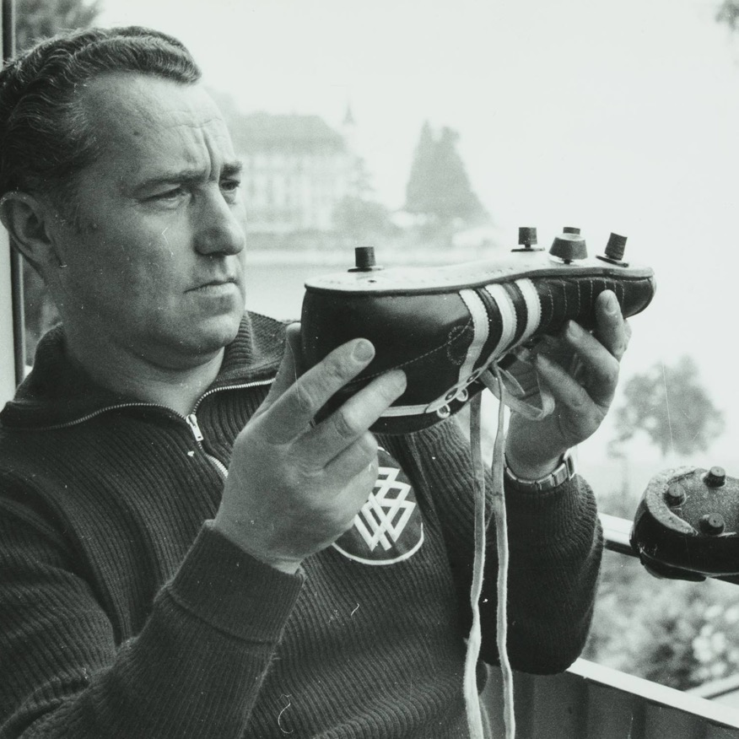
Consumer experience on our biggest shop has to be as reliable as our products

Slide 15

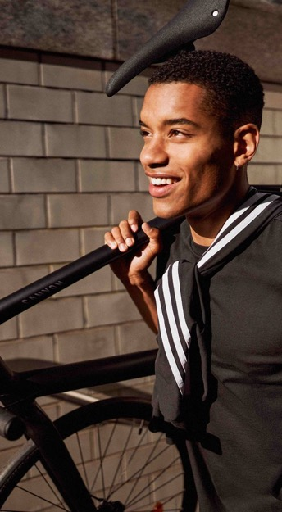


10x mindset is needed to run a 9 billion shop at this mind boggling scale
Production deployments
Multiple deployments per day
Peak order rate
3000 orders/Min
Consumer comms
11 B
168 m members
Hype drop visits
1.5 m/sec
Over 200 hype drops in 2020

Slide 16
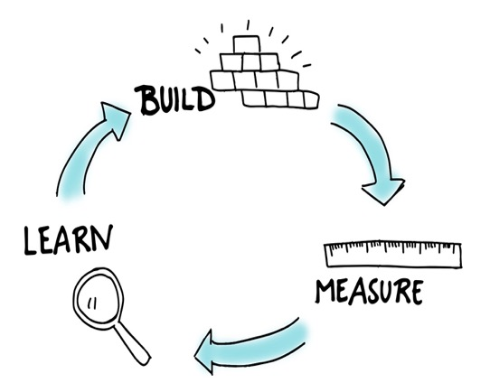




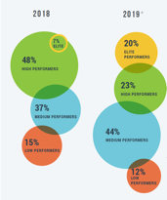
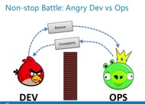
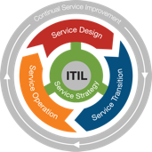
Our journey from a reliable to a stable and resilient consumer experience
Evolution of stability and resilience KPIS to more business focused
Three pillars to success
Observability (AIOPS)
Resilience
Release Excellence (Error Budget @scale)
Key ITIL practices
Key SRE practices tailored at scale
Reliability is the key to maintain competitive advantage
Semi - Autonomous
# P1 , MTTR ,MTTD, MTBSI
A KPI that brought all of us together
%Revenue Bleed vs Net Sales
Traditional Operational KPI
P1 SLA , P2 SLA…
#one team one backlog
Everything is connected.

Slide 17
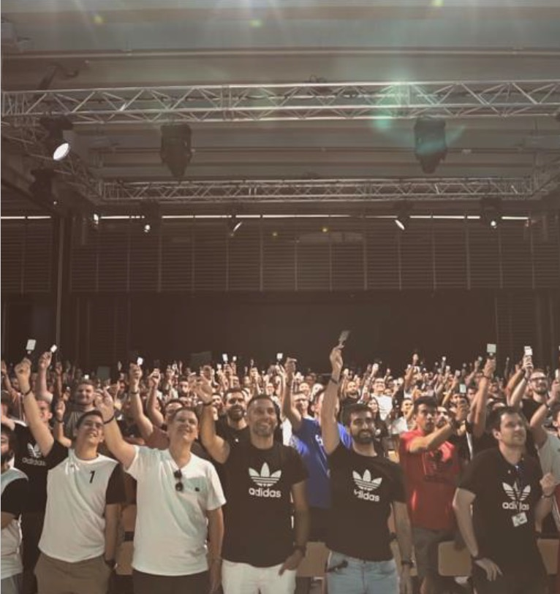
Release fitness
“BUY FREEDOM FOR THE PRODUCT TEAMS”
THROUGH
AFFORDABLE GOVERNANCE
AND FOCUS ON
VALUE STREAM STABILITY
Notes:
Link to it’s not only my system, but all the environment message Fernando shared at the beginning
By now you all know how our ecosystem grew and release became complex, not because of the system themselves, but because of the environment. We have now many different systems that interconnect and in order to release something many checks need to be validated.
This is release fitness, where teams can buy freedom for the product through affordable governance and focus on value stream stability.

Slide 18
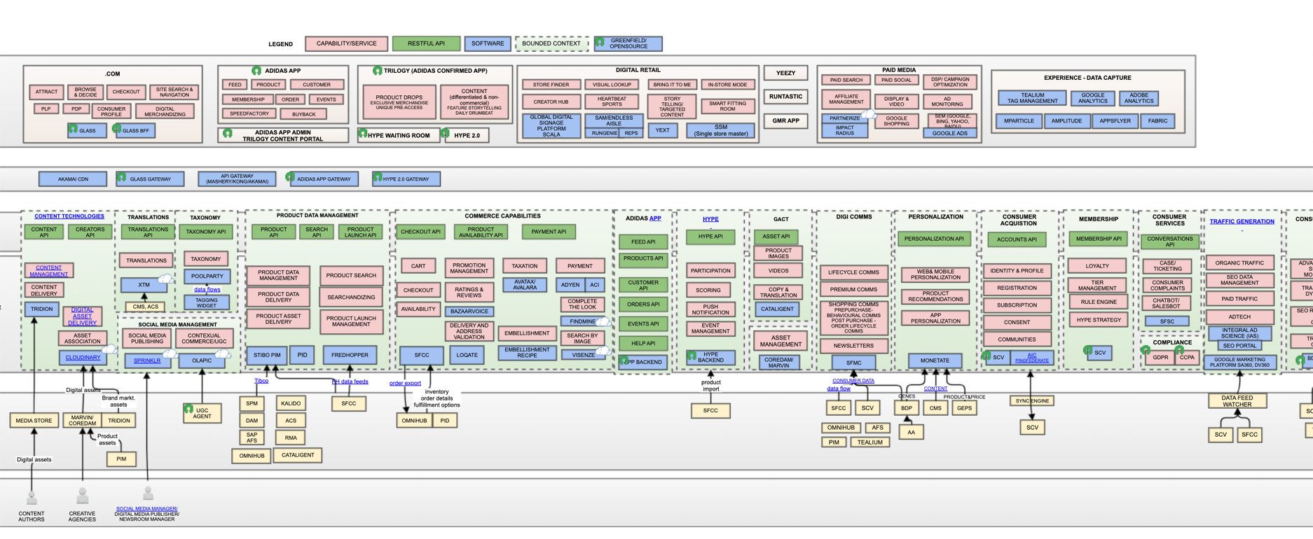
Adidas Web and Mobile

Slide 19

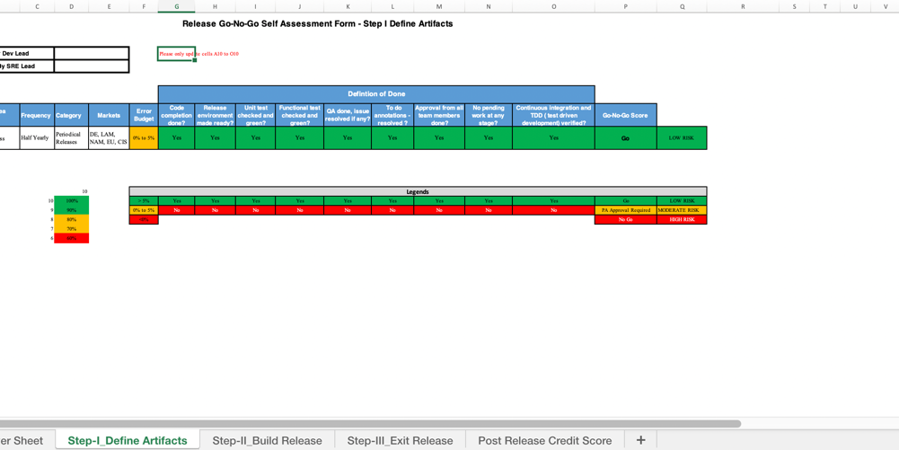
Challenges
From couple of services in production to
developing digital products at scale
3 VPs in a room to approve releases
Release process with manual input
Notes:
Back in November, Imagine 3 VPs in a room, how expensive, time consuming and boring this process was?!
Ok, then we worked on the process together with the product teams and then handed over an excel with them with all the checks they need to mark before release. Now imagine we have quite fast paced teams working to release daily, when they received the new process and from now on they have to manually check everything and update the excel. Of course nobody liked, but what if we can automate all the communication, most of the checks and have one single signal as a combination of all KPIs / factors?
It’s release fitness
One single signal, go or no go, created as a combination of all factors to be used automated in production release pipelines!

Slide 20
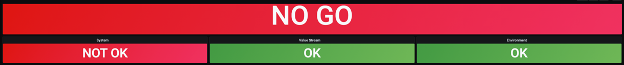
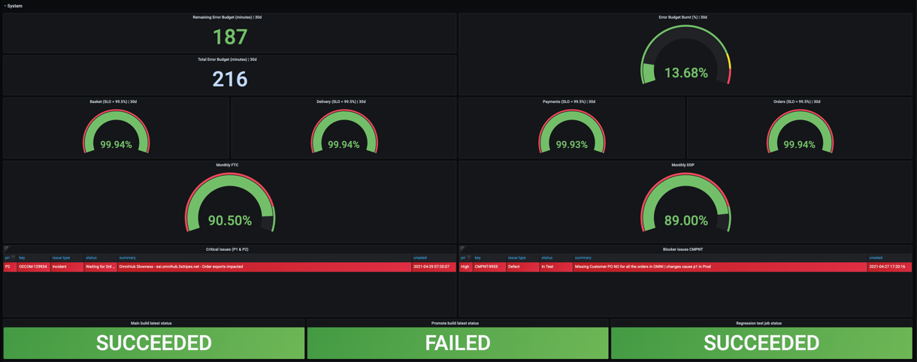
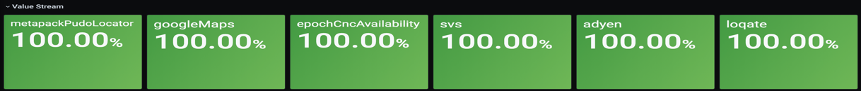
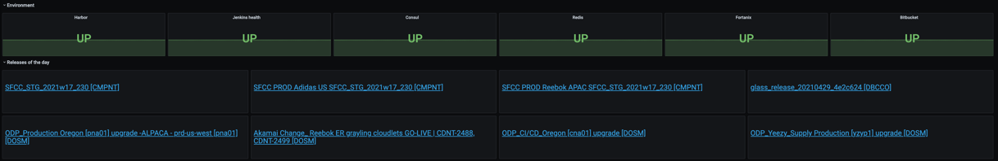
Release fitness
Release based on kpis
Unique signal based on set of KPIs
Product level
Error Budget, CI/CD, QA, blocker issues
Value Stream
Dependencies
Environment
Platforms
Releases of the day
Notes:
Examples what can go wrong
Cognitive load – get reduced a lot
Link number to developers
Annalogy – bonus – 3 dimensions / your / department / industry
My own product
Explain value stream at adidas – checkout value stream
Environment
Next steps -> We are rolling out to other areas
Handover to Fernando

Slide 21

WHY KEEP COMING EVERY YEAR
Notes:
Thanks a lot Vikalp and Andreia. This is fantastic and taking us to the next level definitely.
I personally love systems that self-adjust and regulate. Like in this case:
On one hand having strict release guidelines
On the other having automated fitness checks and error budgets telling every engineer when can or cannot deploy
I just want to close with a reflection than Gene asked me…. Why adidas keeps coming every year to the DevOps Enterprise if we are at the forefront?
For me, it’s definitely:
Reflecting the yearly progress, learning by teaching the things you do well
Learning from others, things they do better
Being close to the community, Jason Cox, Jon Smart, Matthew Skelton, Mik Kersten… our colleagues from Jaguar, BMW…
And new people reaching us after each talk or Youtube visualization
Last but not least, on top, I have the luxury of being an early reviewer of some of the most fantastic books on ITRevolution
So, I have no doubt I’ll be back next year. Hope you enjoyed as much as I did!

Slide 22
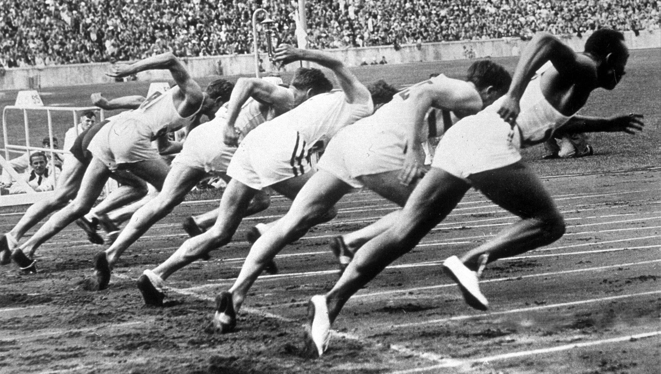
THANK YOU!

